Slide 1
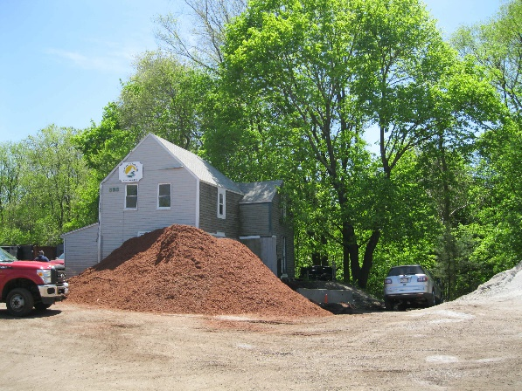
City of Newton
Planning and Development
Comprehensive Permit #04-23
For a six-story all-residential development with 198 residential units
7/24/2023
528 Boylston Street

Slide 2
Project Overview
Site: 253,454 square foot (5.82 acre) lot
        SR 1 and SR2 Zoning District
Proposal: Comprehensive Permit under M.G.L. Chapter 40B to construct:
6 story residential only building
        198 residential units
        273 parking stalls
        50 units (25%) deed-restricted as permanently affordable to households at up to 80 percent (80%) of Area Median Income (AMI)

Slide 3
Changes Since May
 | May Proposal | June Proposal
Housing | 244 units | 198 units
Affordable units | 61 (25% of all units) | 50 (25% of all units)
Height | 6 stories, 70 feet | 6 stories, 70 feet
FAR | 1.95 | 1.66

Slide 4
Changes Since May
 | May Proposal | June Proposal
Front setback | 17.2 feet | 27.8 feet
Rear setback | 35.8 feet | 43.9 feet
Side setback | 59.8 feet | 58.1
Parking | 385 stalls | 273 stalls

Slide 5
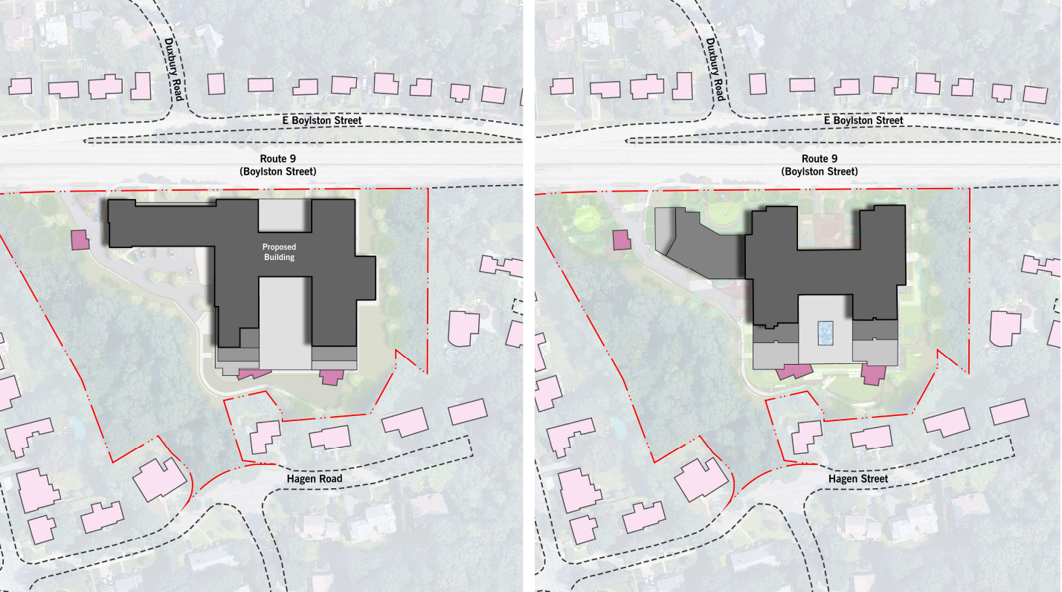
Proposed Design
May 2023
July 2023

Slide 6
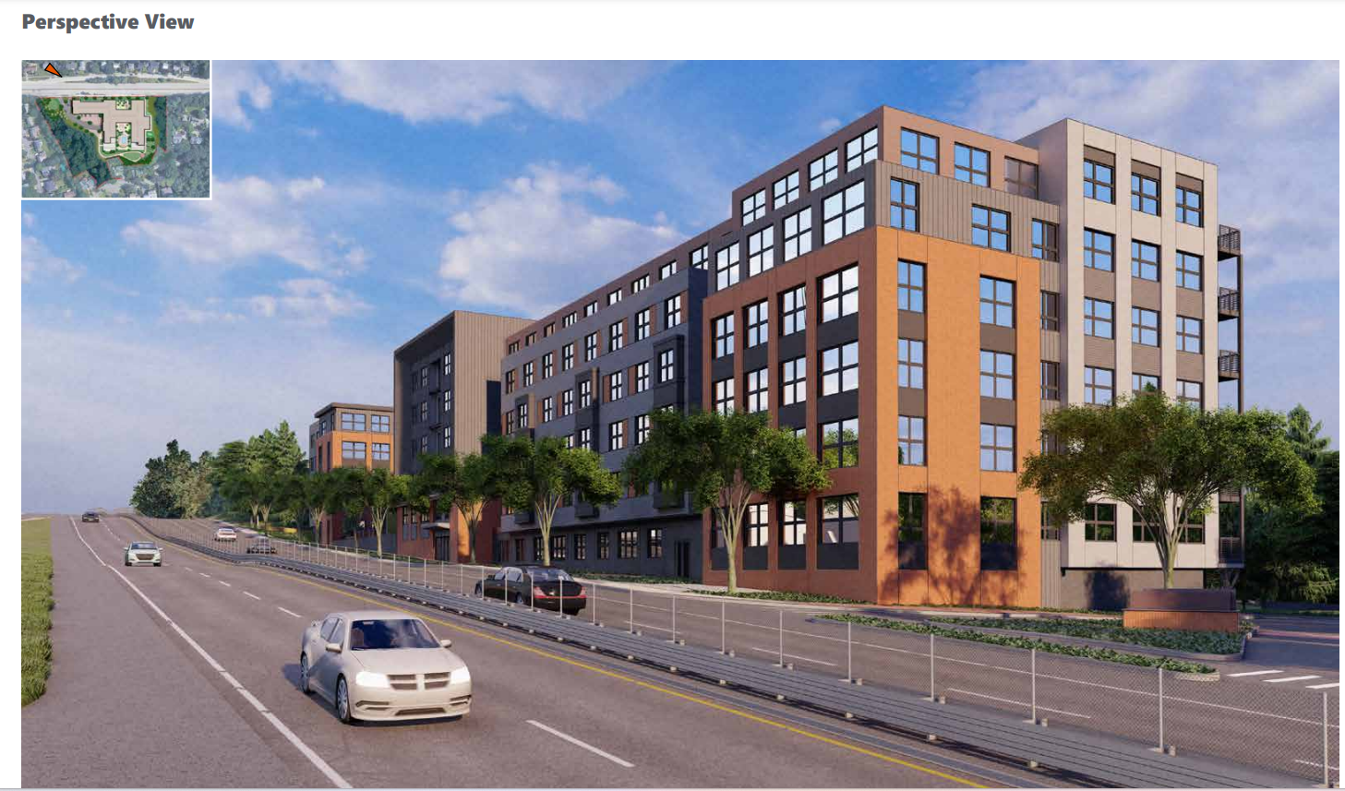
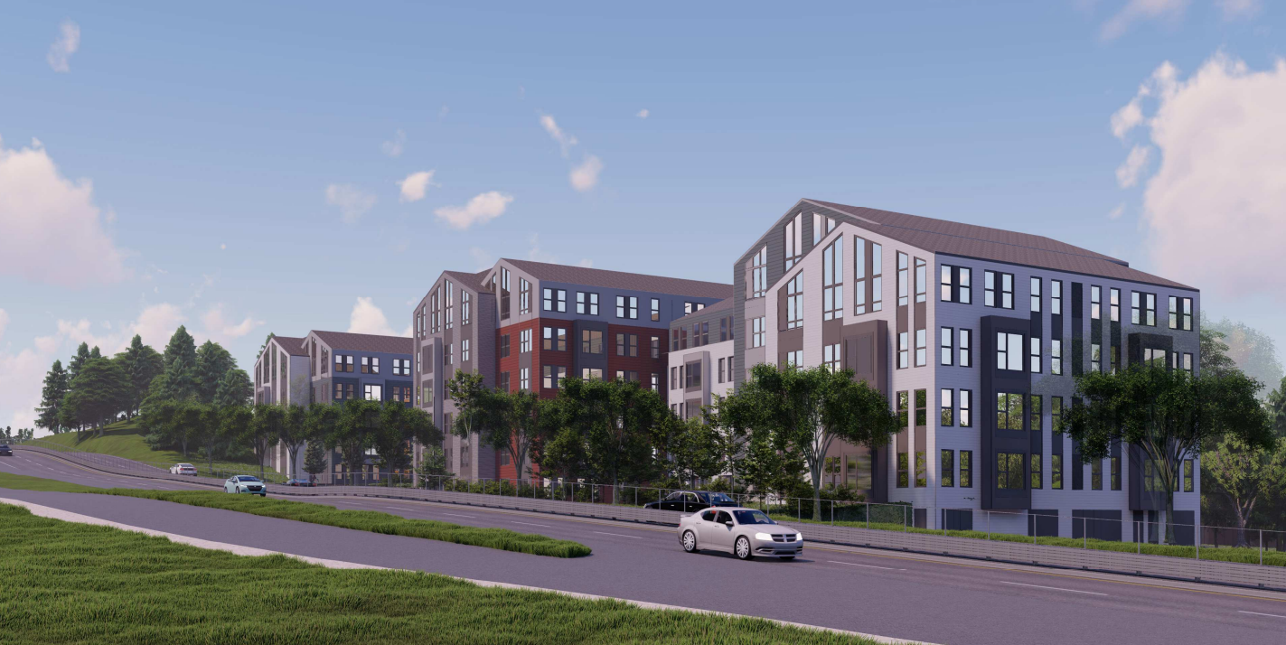
View from Boylston Street (proposed)
May 2023
July 2023

Slide 7
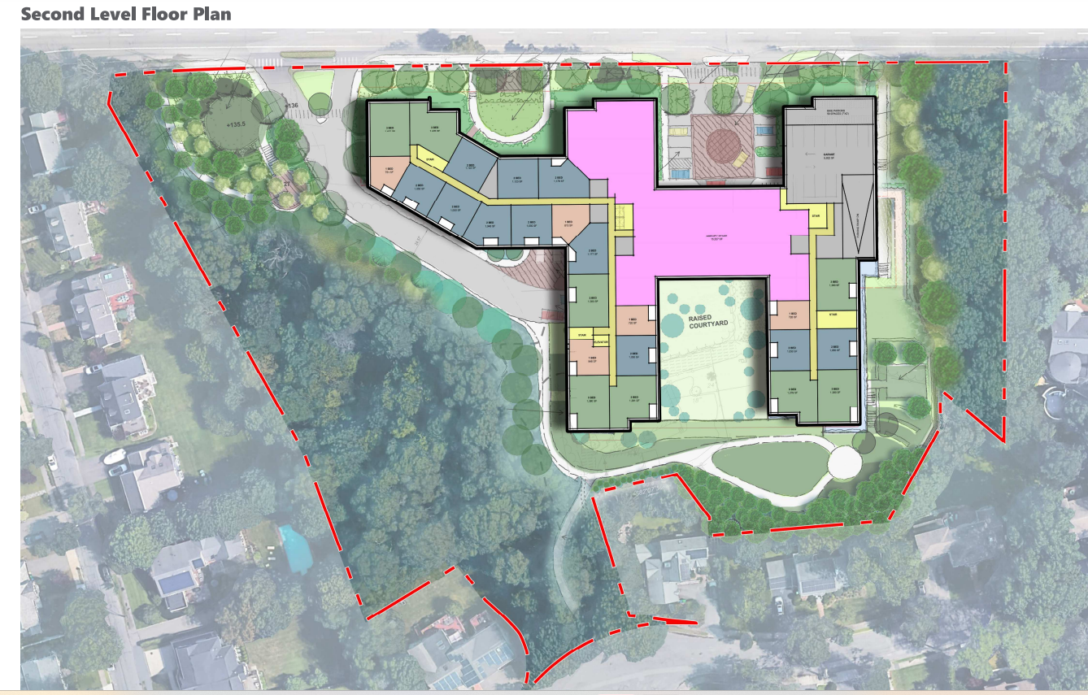
Second Level Floor Plan

Slide 8
City Review
Department | Status | Details
Urban Design Commission | To be updated | -Review for May design complete, but has not reviewed revised design
Sewer Inflow & Infiltration analysis | Complete | -I&I fee updated by Engineering
Urban Forestry | To be updated | -Review for May design complete, but has not reviewed revised design
Stormwater | Complete | -Memo updated by Engineering
Conservation Commission | Awaiting Review | -
Historic | Awaiting Review | -

Slide 9
Peer Reviews
Consultant | Topic area | Concerns to address
Horsley Witten | Sustainability, stormwater, site design | Sustainability in design and construction practices Ability to achieve Passive House certification
BETA Group, Inc. | Traffic and transportation | Parking ratio Access to and from the site from Route 9 Review of transportation demand measures
NBBJ | Building design | Building massing and height Architecture & design

Slide 10

Next Steps
Requested materials:
  Complete plan set
  Shadow study
  Three-dimensional (3D) physical model of the project
  Revised Traffic Study
  Detailed lighting plan
Future meetings to focus on:
  Transportation & traffic
  Stormwater/site design

